Slide 1
Project Presentation
NLP : Hate Speech detection using Machine Learning
Hiten Chadha

Slide 2

A brief introduction
Hate speech is something that can potentially attack a person or group on the basis of race, religion, gender, disability, ethnic origin etc.
Social Media Platforms nowadays, like twitter has constantly in the recent years raised concerns against such activity being done by users and taking necessary actions to address the problem

Slide 3
Overview
Objective
EDA Presentation
ML Models for training
Model Comparison
Final Recommendation

Slide 4
Objective
The main objective of the project is to develop an automated model to detect hate speech in twitter tweets
Develop and compare different Machine Learning models for the problem and produce the final recommendation

Slide 5
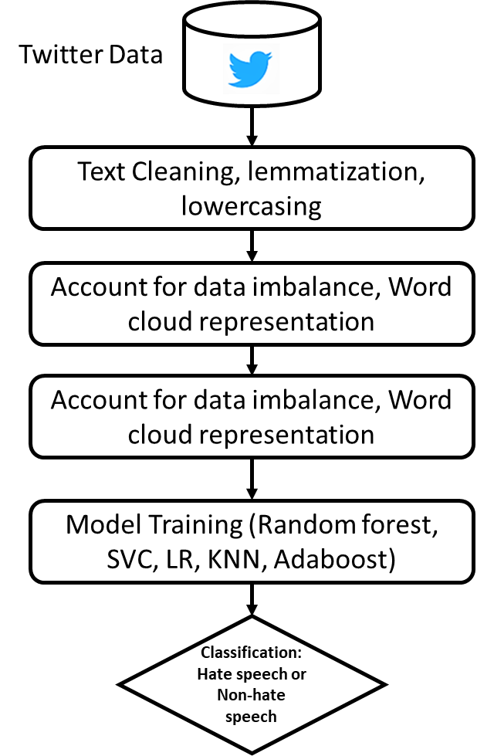
Process Flowchart
Data Pre-Processing
Feature Extraction
TFID-Vectorization
Classification

Slide 6
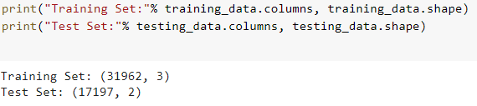
Data-Pre Processing
Kaggle Dataset
The source has 31962 and 17197 tweets in the training and test data set respectively.

Slide 7
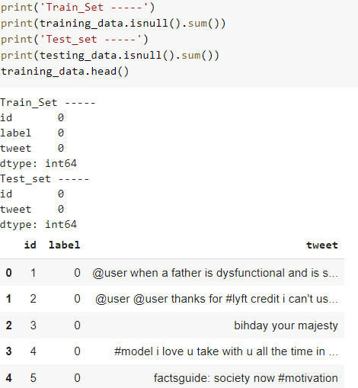
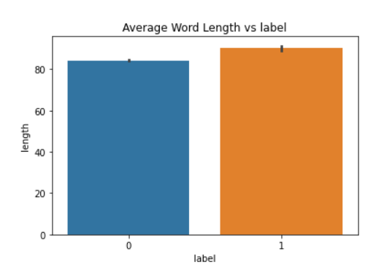
Data Pre-processing --Null Data
Dealing with null data
Average tweet length
There are no null data in the datasets.

Slide 8
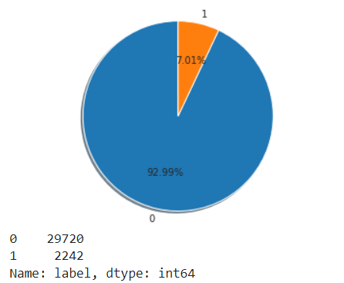
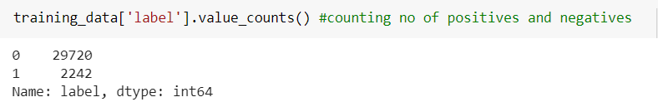
Positive and Negative tweet distribution
There are 2242 hate speech tweets as compared to 29720 non-hate speech tweets in the training data provided and the rest contains no hate speech.
Clearly, there is a data imbalance issue that needs to be rectified first

Slide 9
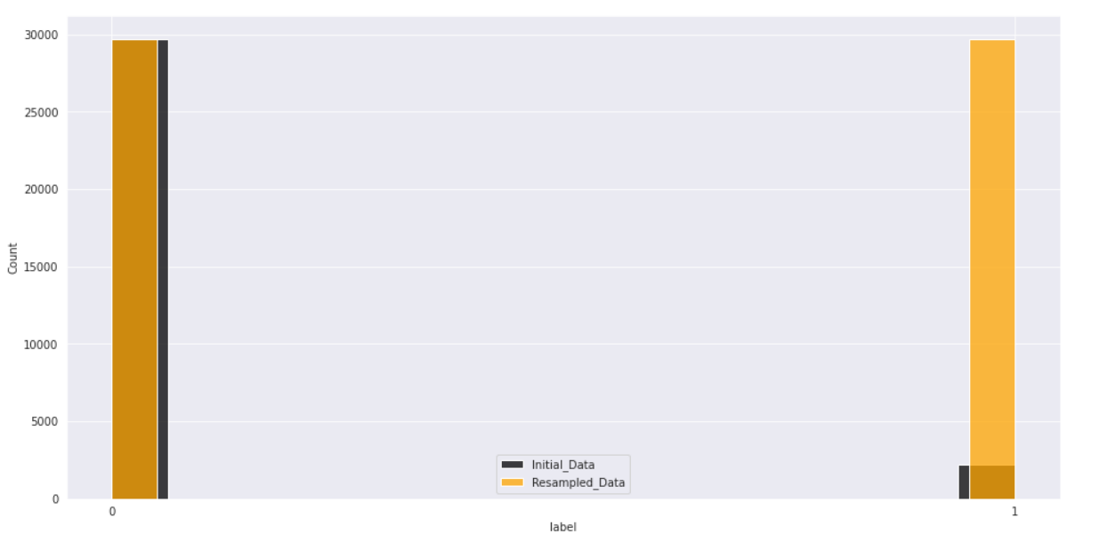
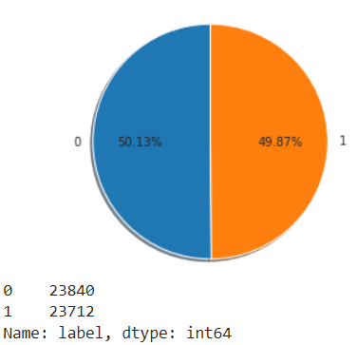
Oversampling for Data/Class Imbalance
Initial data(black) and after sampling data(orange) for hate and non hate words

Slide 10
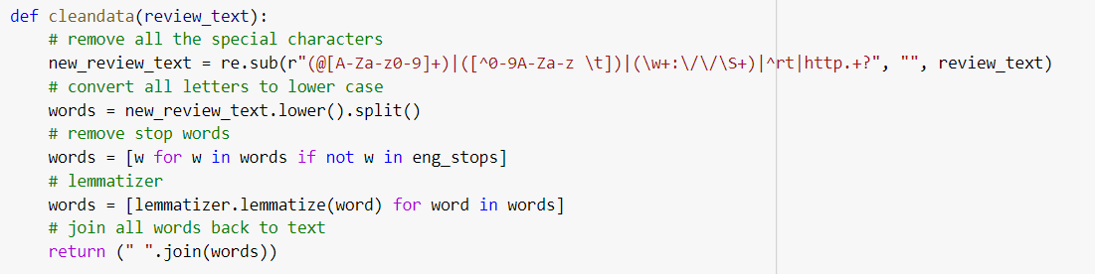
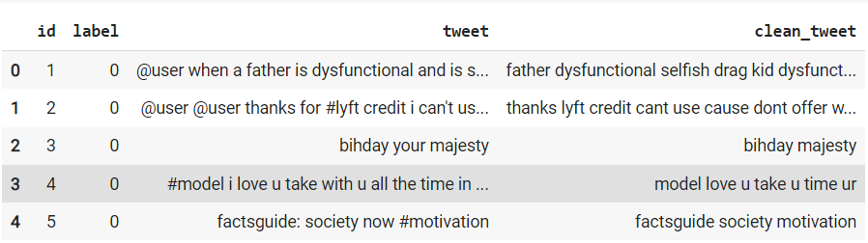
Text Cleaning

Slide 11
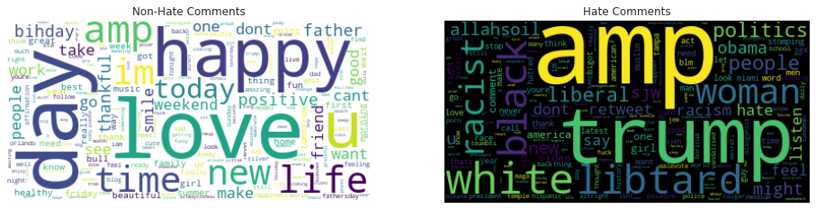
Word cloud representation

Slide 12
ML Models for Training
Logistic Regression
MultinomialNB
SGD Classifier
DecisionTreeClassifier
Random Forest Classifier
KNNeighbors Classifier
Linear SVC
Adaboost Classifier

Slide 13
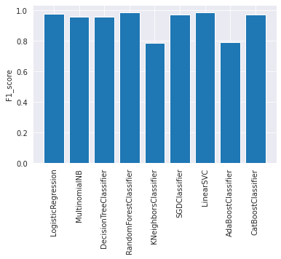
Model Comparison
A classification report along with confusion matrix is visualized for each classifier
F1_score for all classifier is calculated and compared as shown

Slide 14
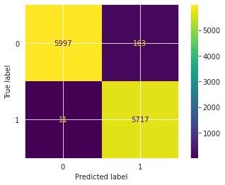
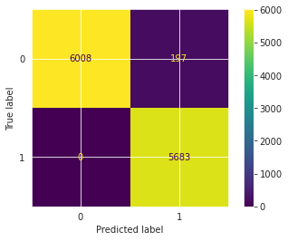
Final Recommendation and future work
For the given problem, the recommended model used should be Random Forest Classifier or Linear SVC with an f1_score of 0.98.
However, Random Forest is a better choice as it has proven to be more robust with other test data
BERT/RoBERTa models might work even better for such a task, as more features can be developed.
Linear SVC
Random Forest

Slide 15
Thank You

